Slide 1
DM2004 Online Advertising and Analytics
Assignment
Student Name: Student NRIC / FIN No. | Date:

Slide 2

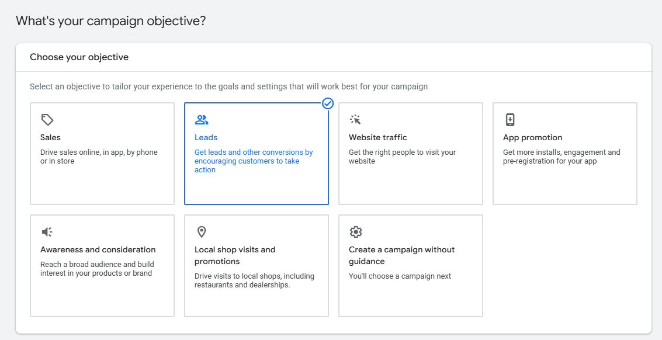
Campaign Level Activity 1/7
Screenshot and paste below the Campaign Objective Setup as per required in the scenario

Slide 3
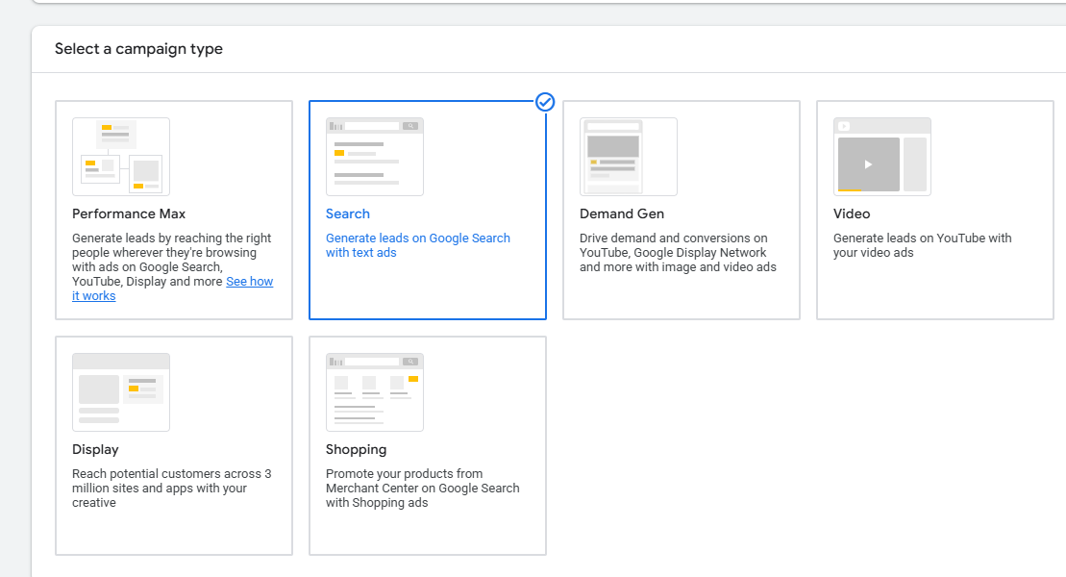
Campaign Level Activity 2/7
Screenshot and paste below the Campaign Type Setting as per required in the Scenario

Slide 4
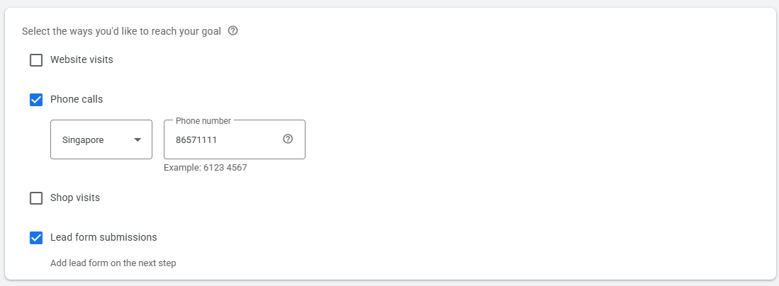
Campaign Level Activity 3/7
Screenshot and paste below the Campaign Goal (Note: Just provide a dummy Singapore Phone number/Not a real one)

Slide 5
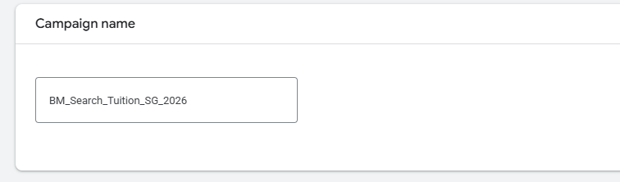
Campaign Level Activity 4/7
Screenshot and paste below the Campaign Name as per required in the Scenario

Slide 6
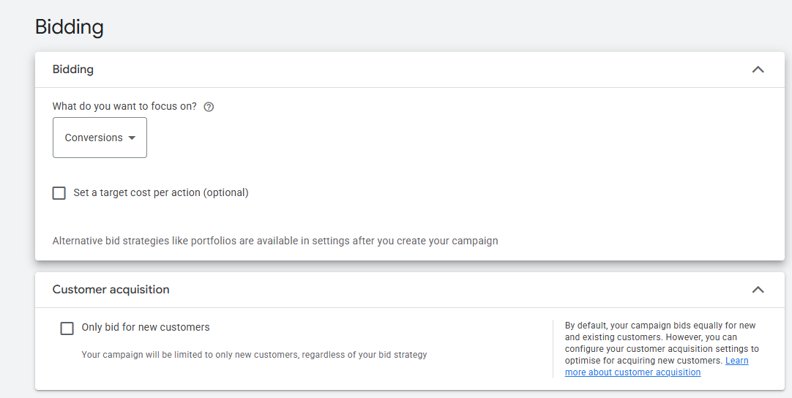
Campaign Level Activity 5/7
Screenshot and paste below the Bidding Strategy as per required in the scenario

Slide 7
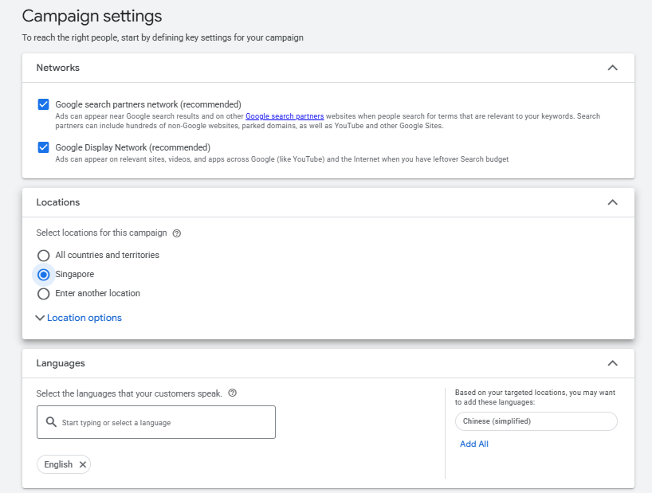
Campaign Level Activity 6/7
Screenshot and paste below the Campaign Settings (Network: Google Search Network Display Only (Exclude Display) Location: Singapore, Language: English) as per required in the scenario

Slide 8
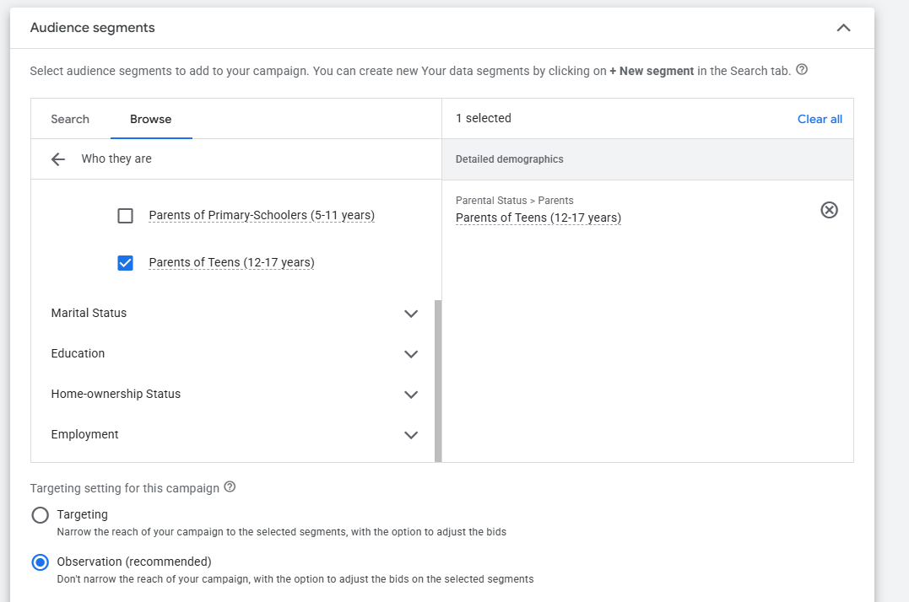
Campaign Level Activity 6/7
Screenshot and paste below the Audience Segment [Parents of Teens (12-17 years)]

Slide 9
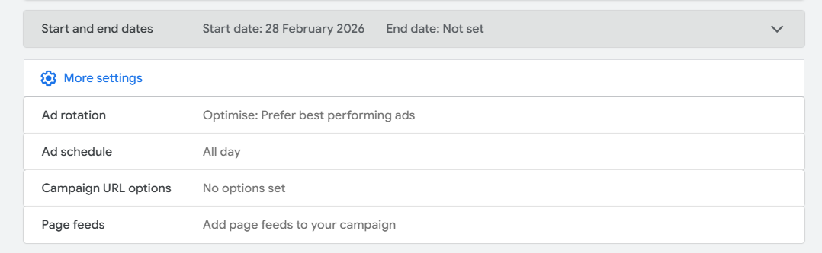
Campaign Level Activity 7/7
Screenshot and paste below the Ad Rotation (Optimize) and More Settings (Start Date: February 28, 2026, Ad Schedule: All Day))

Slide 10
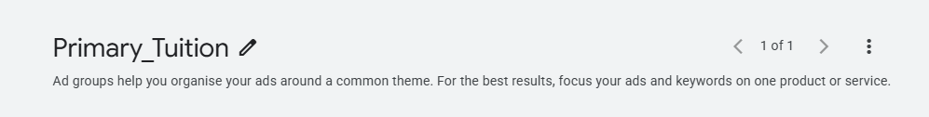
Ad Group Level Activity 1/7
Screenshot and paste below the set Ad Group 1 Name as per required in the Scenario

Slide 11
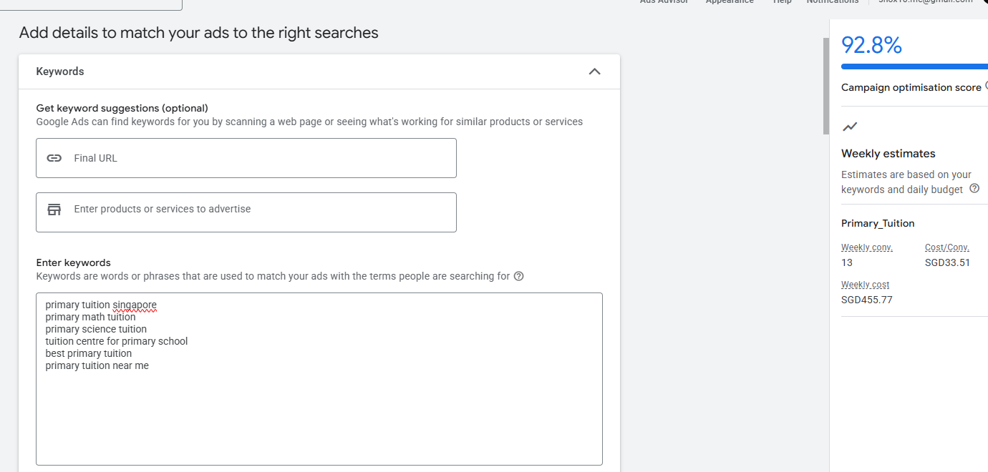
Ad Group Level Activity 2/7
Screenshot and paste below the set Ad Group 1 Keywords and the Campaign Optimization Score

Slide 12
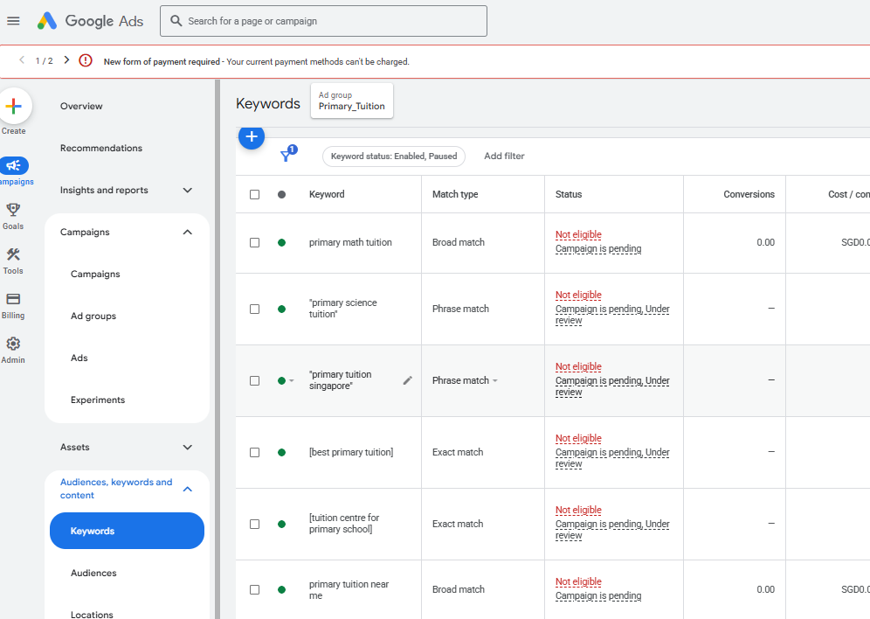
Ad Group Level Activity 3/7
Screenshot and paste below the Matching Type of Ad Group 1 Keywords (2 Phrase Match, 2 Exact Match and 1 Broad Match) as per required in the scenario

Slide 13
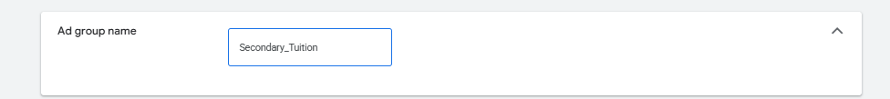
Ad Group Level Activity 4/7
Screenshot and paste below the Ad Group 2 Name as per required in the Scenario

Slide 14
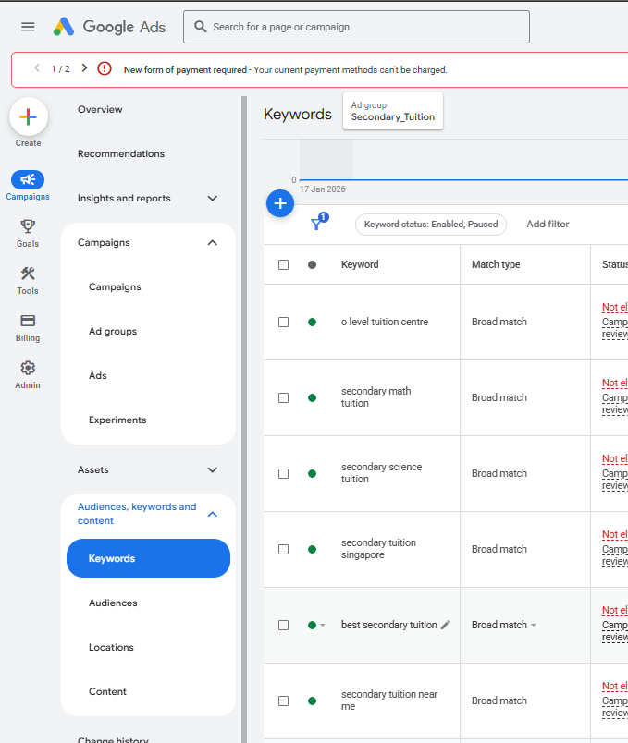
Ad Group Level Activity 5/7
Screenshot and paste below the Ad Group 2 Keyword Settings as per required in the Scenario

Slide 15
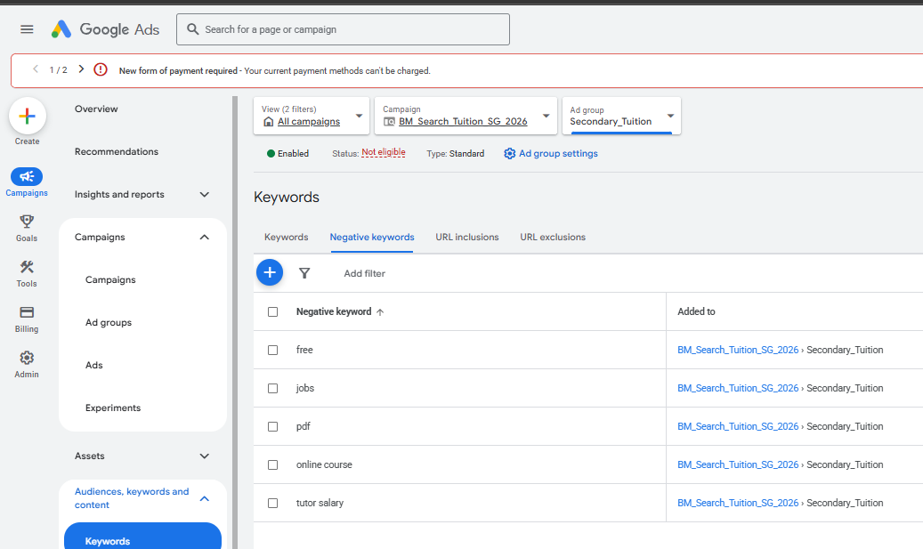
Ad Group Level Activity 6/7
Screenshot and paste below the Ad Group 2 Negative keywords set-up

Slide 16
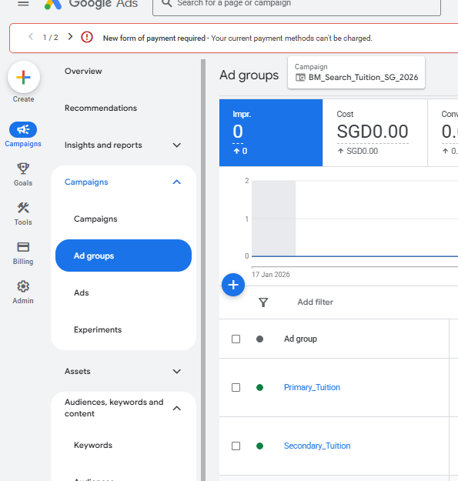
Ad Group Level Activity 7/7
Screenshot and paste below the Ad Group 1 and Ad Group 2 Lists

Slide 17
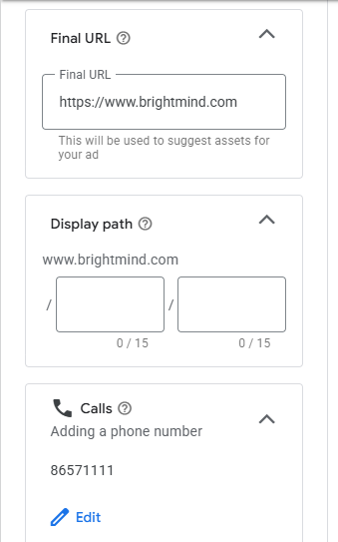
Ad Level Activity 1/4
Screenshot and paste below the set Ad Level (Final URL: https://www.brightmind.com, Call No.: 86571111)

Slide 18
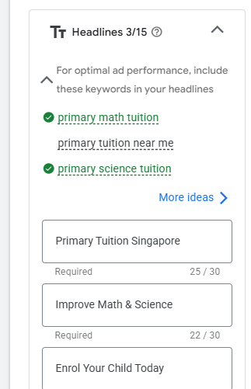
Ad Level Activity 2/4
Screenshot and paste below the set Ad Level (3 Headlines: 1 Headline with location (Singapore), 1 Headline with benefit, 1 Headline with CTA)

Slide 19
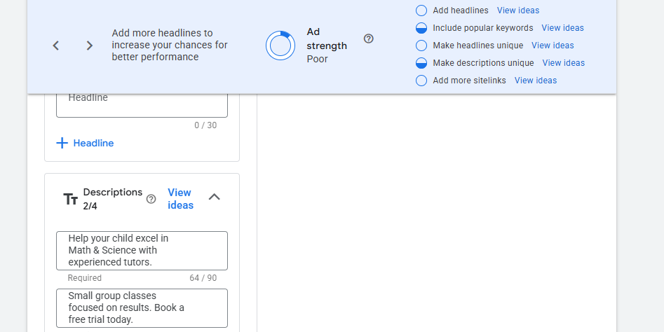
Ad Level Activity 3/4
Screenshot and paste below the set Ad Level (2 Descriptions: 1 description with value proposition, 1 description with CTA)

Slide 20
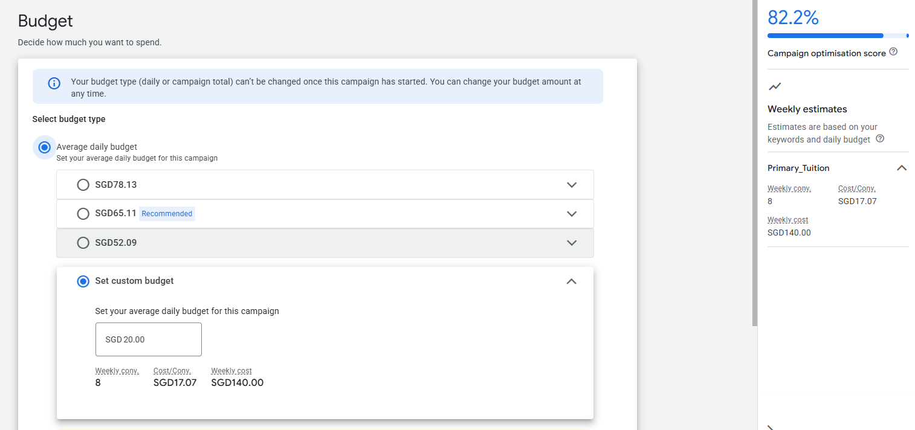
Ad Level Activity 4/4
Screenshot and paste below the set Ad Level Budget of SGD 20.00

